Slide 1
OUR JOURNEY TO REMOTE LEARNING​
By:
Kim Blanchard
Sharmen Ibrahim

Slide 2
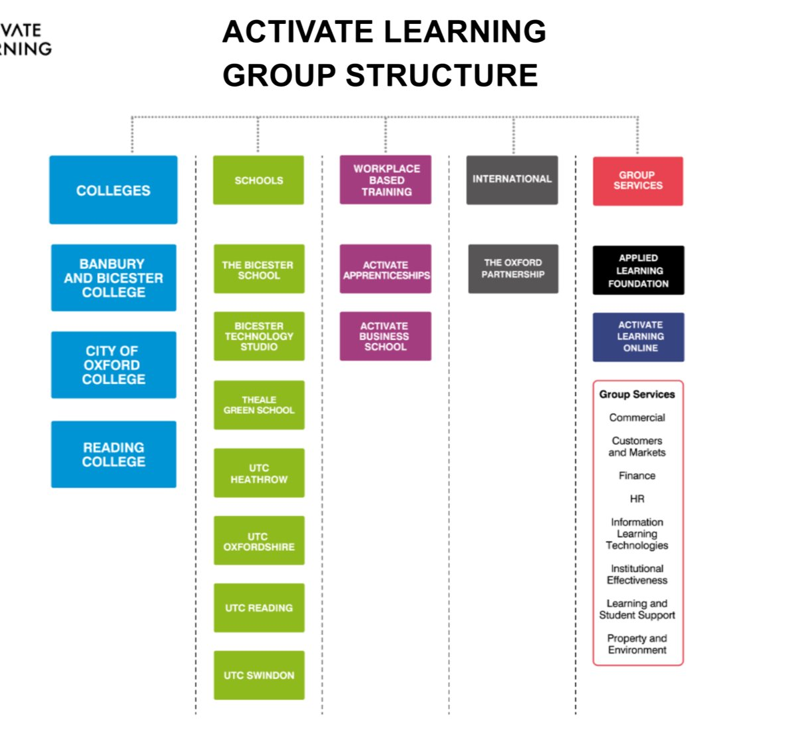
Who are we?
Activate Learning ONLINE is our Canvas based VLE ​
It is currently used in our FE colleges​
It is managed by the digital education team​
Notes:
KB

Slide 3

When/where did we start?
We have used Canvas since September 2017
With Covid, about a three weeks before the Government decided to close schools and colleges we started reading the signs and felt we had better get prepared for a scenario the like of which none of us had ever seen in our lifetimes.​
We shifted ‘heaven and earth’ to create training material and video tutorials for the uninitiated around the conferencing tool in Canvas. We decided to use Big Blue Button.
We then spent two solid days testing, testing and testing again with learners whilst they were still on our college sites to make sure that they understood the platforms and what would be expected of them.​
Notes:
KB

Slide 4

Why Canvas?
All your resources, assessment, feedback and collaboration in one place with a journey for the learner to follow. The learners are NOT sent off to a list of files and folders, instead there is a flow which is just right for learning in circumstances like these.​
It comes with New Analytics where teachers can see at a glance the activity of the class or the individuals.
It supports SCORM content which are ideal for distance learning without the learners getting bored of reading LONG flat documents!​
Last but not least, it has the Big Blue Button which is a great conferencing tool that allows you to have groups and 1:1s. Our teachers LOVE the BreakOut rooms feature!
Notes:
KB

Slide 5
Robust LTI integrations:
Cidilabs tools - This suite of design tools which allows us to utilise the blueprint functionality for consistency, quality and efficiency of development. Supports and organisational approach
Office 365 – integration of Class Onenote notebook, etc
Google Drive
Badgr
Turnitin
And a wide range of edtech tools such as FlipGrid
Notes:
KB

Slide 6
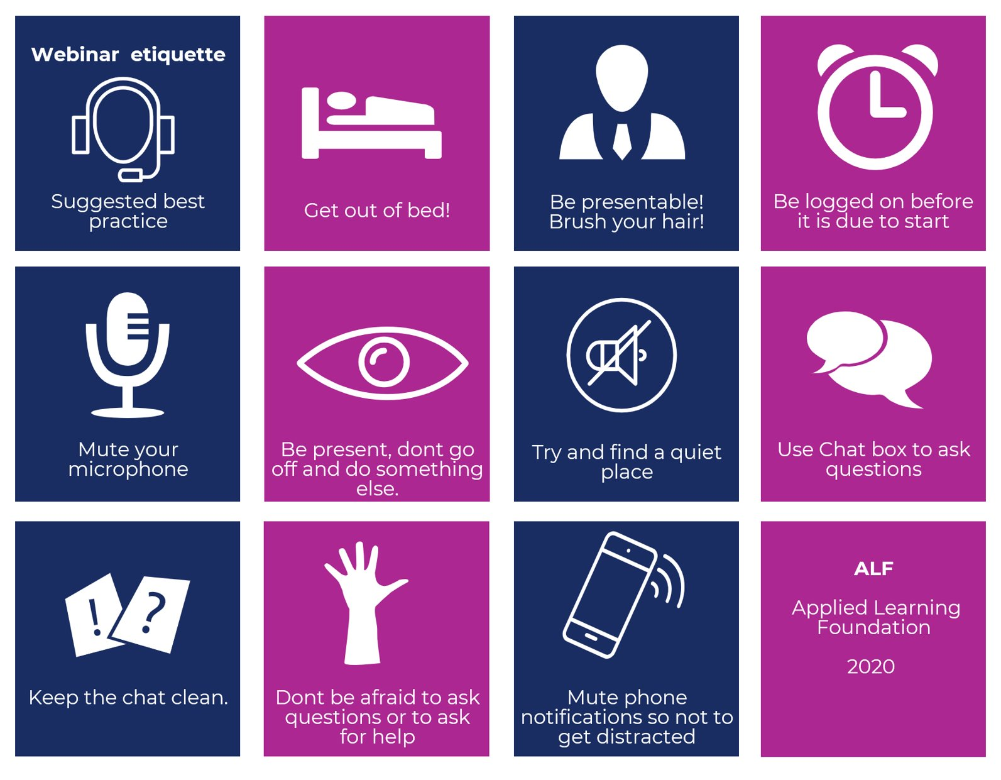

What support did we give our staff? ​
Training, training, training
and…. training!​
​
Notes:
KB

Slide 7
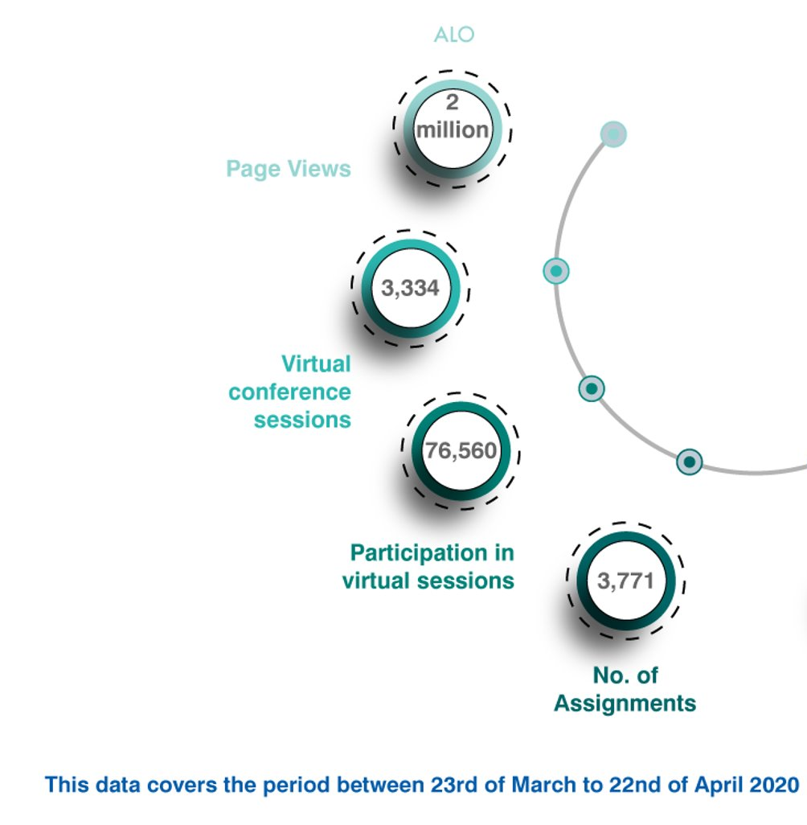
How did we do?
We have been blown away by the uptake!​
After the first week (23 to 28 March), the analytics tell us:
1,371 live conferences took place for students​
1,770 ‘assignments’ were set for students through ALO​
7,100 ‘unique learners’ participated in the ALO learning and conferencing platform​
40,905 individual enrolments to online conferencing sessions occurred.
Notes:
KB

Slide 8
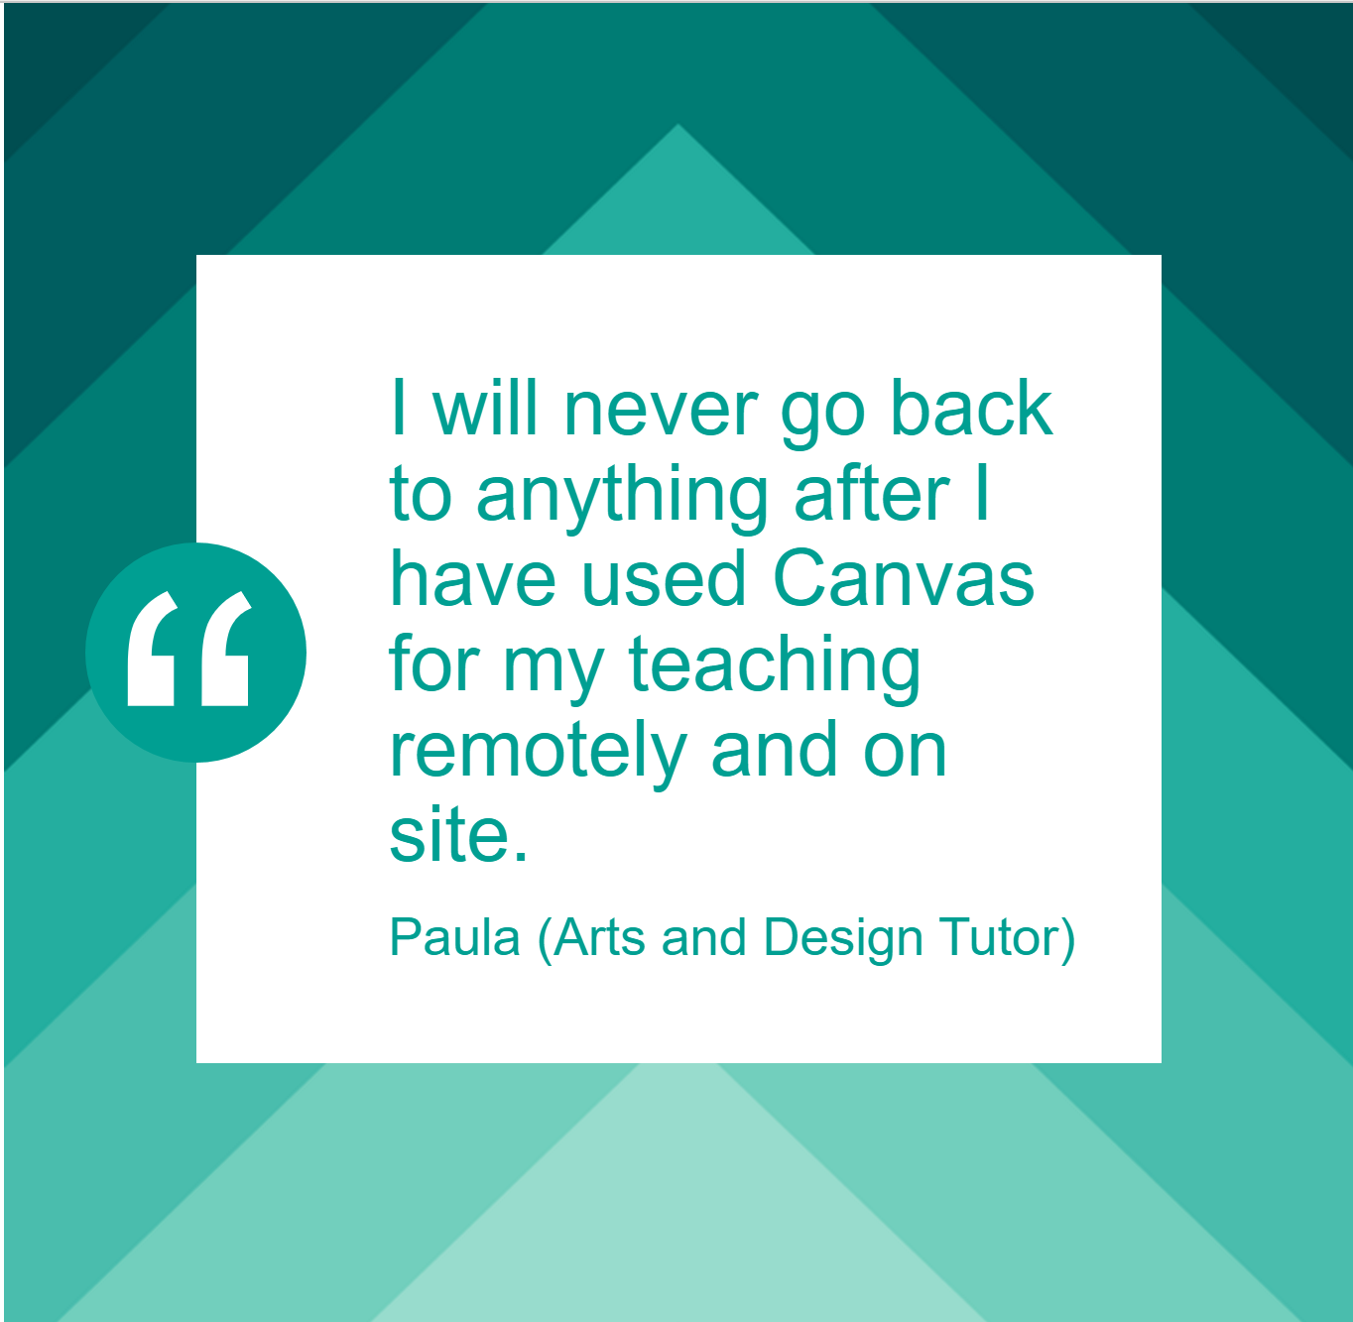
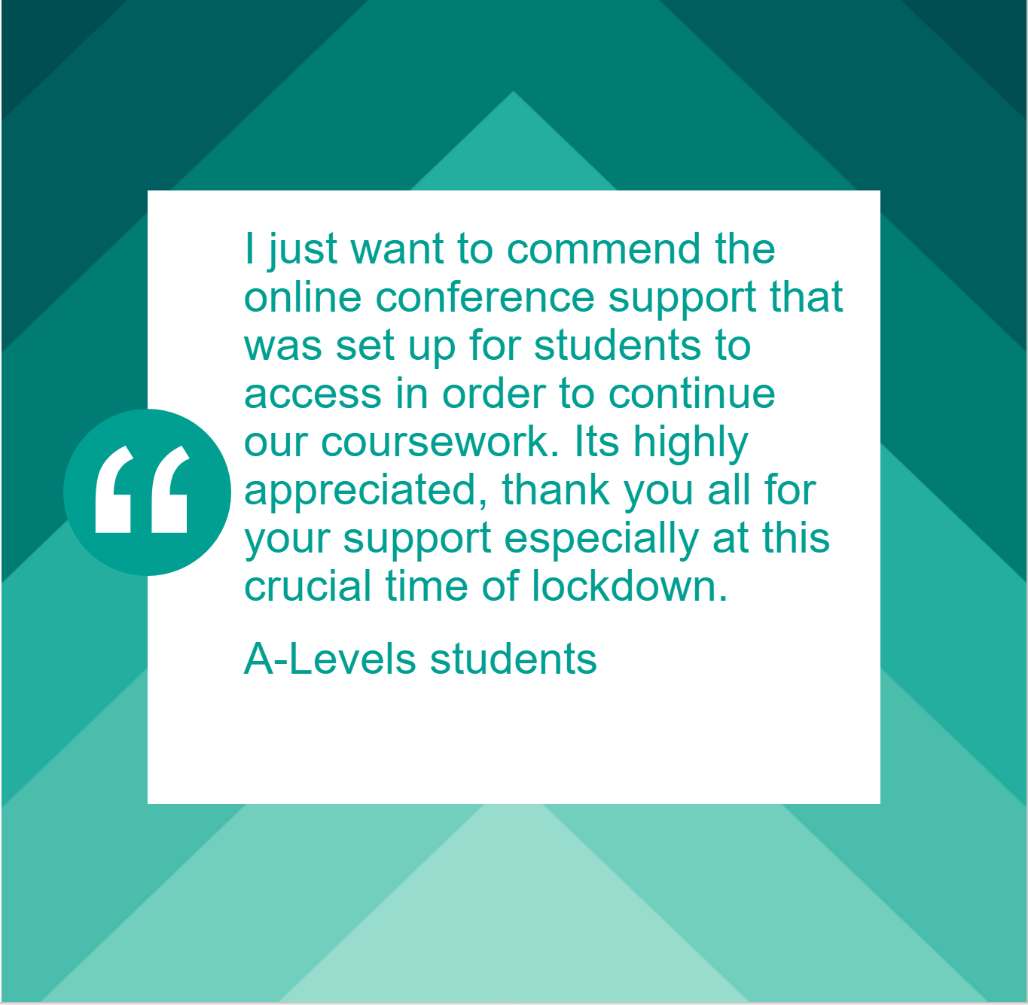
Feedback from staff and students
Notes:
KB

Slide 9
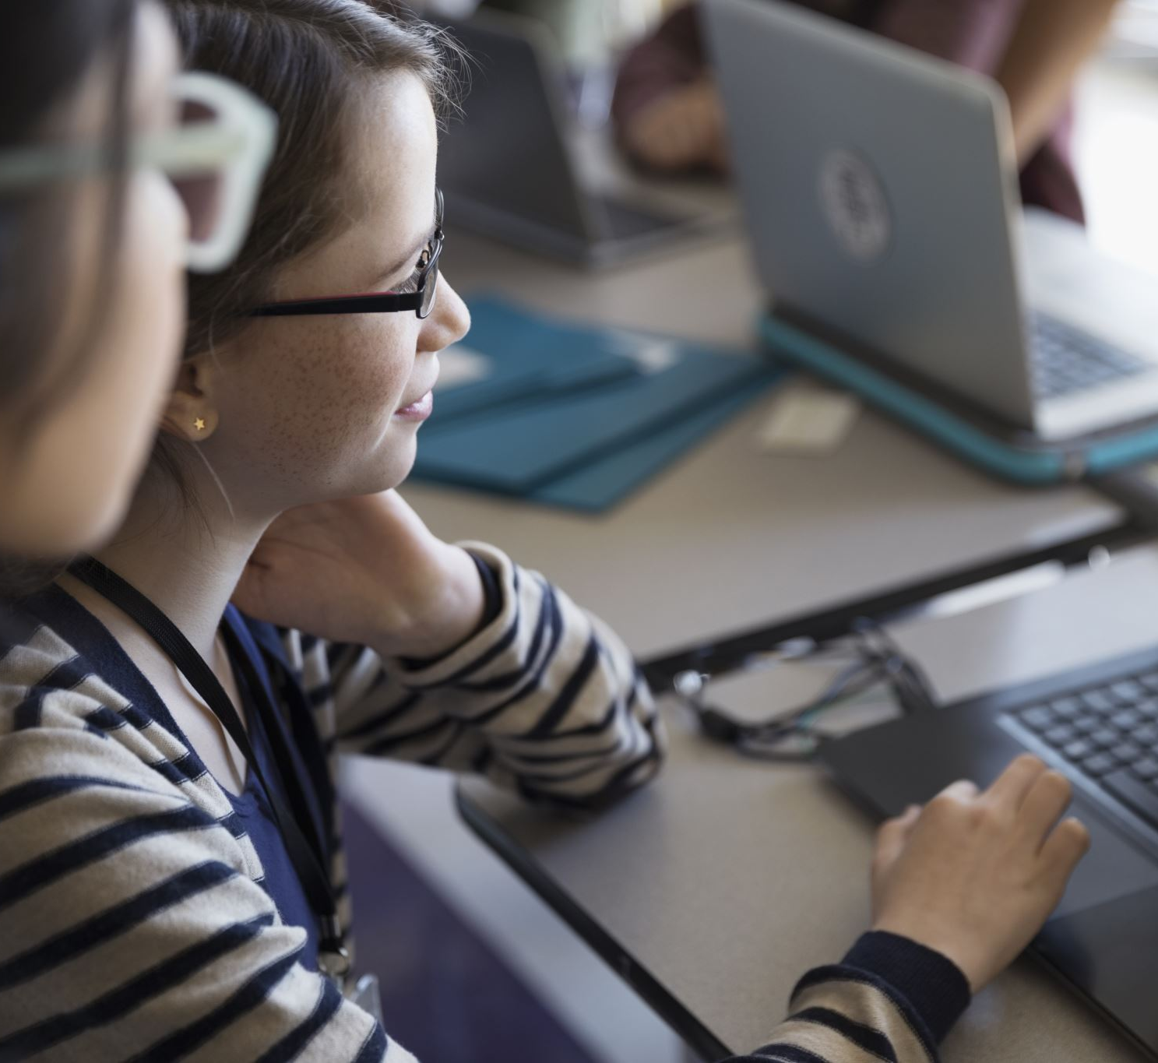
Our online pedagogy model
Our digital strategy states that we aim to:
Implement an innovative, playful and interactive digital technology pedagogy which
places the learner at its heart and which promotes self-directed learning, technology
enhanced classroom learning, blended learning and independent online learning.
In the context of the COVID-19 virus we have found ourselves thrust into developing fully online delivery at speed and under considerable pressure. Whilst this has transformed the skills of many of our teachers, we are aware that extended planning, training and collaboration have not been possible. Careful consideration of what a digital pedagogy is, and is not, has been missed.
Notes:
SI

Slide 10
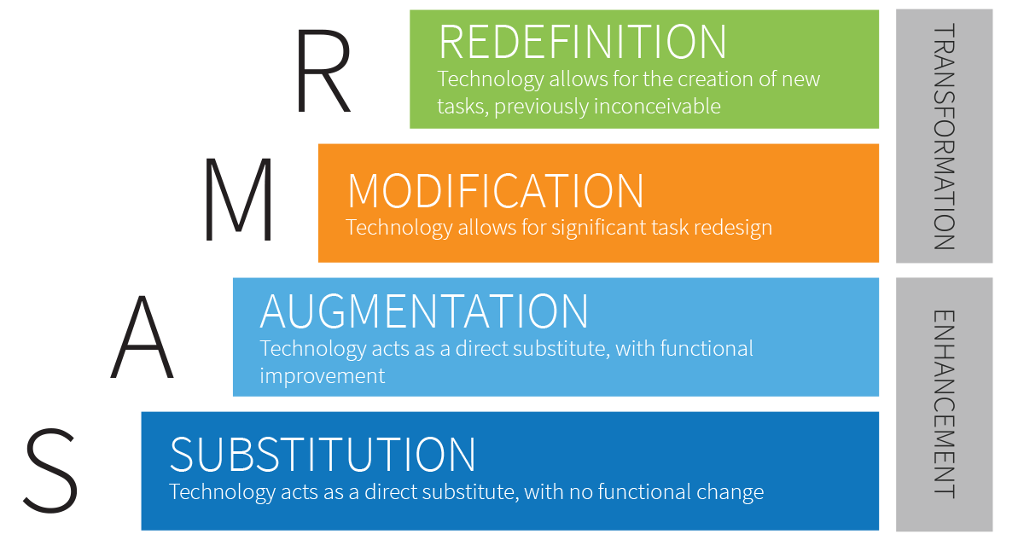
Using the SAMR model
.
Notes:
SI:
Ensure that the use of technologies is soundly pedagogically driven and inspires innovation in teaching, learning and assessment.
In the light of our definition above, we intend for our interpretation of a digital pedagogy to focus on the pedagogy first and then on the digital aspects. In our Digital Strategy (2019) we referenced the SAMR model:
At the lowest level, Substitution, technology acts as a direct substitute and no functional change occurs. In some instances, this is appropriate, such as when we use a device to type notes instead of writing them by hand, reading text online or using a digital drawing programme instead of a paintbrush.
At the second level, Augmentation, technology acts as a direct substitute but, this time, with some functional change. For example, using a text-to-speech function when writing, incorporating a video in a presentation or using Microsoft Forms to deliver and mark a quiz.
At the third level, Modification, the use of technology allows for a significant redesign of the task in hand. Consider recording a sports training exercise and ‘flipping’ the activity so that students watch and analyse it at home or using a scanned background image on a canvas as a starting point for further artistic creativity.
Finally, the highest level is Redefinition. Use concept-mapping tools, create a class documentary or use artificial intelligence driven software such as Century, that provides highly individualised tasks and feedback

Slide 11
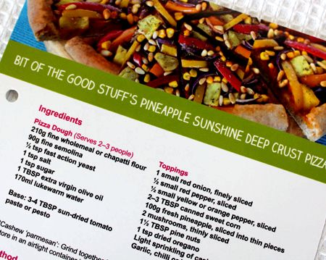
Plan learning and teaching to be delivered through an optimal mix of online, self-directed, blended and face-to-face experiences.
We have created a series of online delivery recipe cards, showing which ingredients are available for use (whether synchronous or asynchronous) and how these different ingredients can be blended into a wide variety of delicious and interesting recipes, keeping our students engaged and our teachers sane.
We will use the BluePrint feature in Canvas to populate all courses in a single faculty.
Notes:
SI

Slide 12
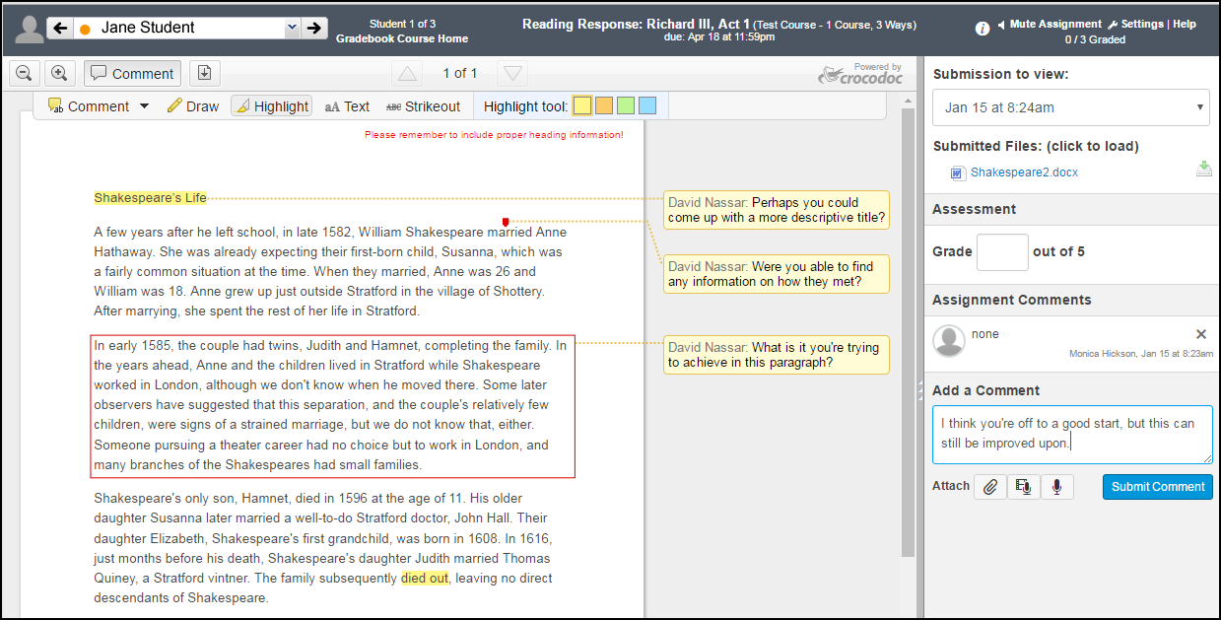
management of assessment which permit e-submission, e-marking and moderation, e-feedback
Speedgrader which is
embedded within
Canvas allows teachers to
grade student's submission,
re-submissions and
moderated assignment with
the option of using a simple
point scale or complex
rubric. Feedback can be
Give in different format such
as text or media comments.
Notes:
SI

Slide 13


include the use of e -portfolios, micro-certification
ePortfolios within Canvas allows students
to collect and document their projects,
submissions, experiences, and other work
products across all their
courses. They keep ePortfolios private or share
with other students, teachers, and/or future
employers. The students can export
their ePortfolios to take them after they finish
studying with Activate Learning.
We use Badgr as a method of adding badges to
courses. Students can collect their badge
upon achieving certain criteria set up by their
teachers and they can add them to their profiles
on LinkedIn, Twitter and other media platforms.
Notes:
SI

Slide 14

Promote the use of plagiarism detection software to support students
Currently Turnitin is widely and routinely used for HE courses, for assignments submitted via Canvas.
We aim to create and run transition course for our Level 3 students progressing to HE, with Activate Learning or externally, next summer. As part of these courses we would like to create short courses in academic writing, including referencing (Harvard), plagiarism and the experience of using plagiarism detection software such as Turnitin.
Notes:
SI

Slide 15

What is next?
We will use Canvas to connect with our perspective students using short online “Micro-Burst” modules. ​
Canvas will be heavily used in our flip-flop model for delivery in September 2020
Our Community Hub! ​where we are using Canvas Catalog
Virtual Art Gallery and a Local Art Festival hosted on Canvas​
Project Based Learning component of all our courses to be delivered online via Canvas. This will include Digital Clubs managed virtually! ​
Linking to PowerBi for reporting and analysis​
Utilising Canvas Catalog for Adult Learning Courses ​
And more!
Notes:
SI

Slide 16
Thank you

